Slide 1
Deep Learning for Lung Nodule Classification in CT Images
Manuel Rocamora, Evgeny Grachev, David Blasco, Anselmo González

Slide 2
Index
01
05
02
06
Introduction
Results
Objectives
Disccusions
03
07
State-of-art
Limitations & Future Work
04
08
Methodology
Conclusiones

Slide 3
01
Introduction

Slide 4
Introduction
The leading cause of cancer-related deaths worldwide.
It is classified into two main types:
Non-Small Cell Lung Cancer (NSCLC): Accounts for 80-85% of cases.
Small Cell Lung Cancer (SCLC): Less common but more aggressive.
Most cases are diagnosed at advanced stages, limiting treatment options.
Advanced imaging and computational tools enable early and accurate detection of lung nodules, reducing mortality.

Slide 5
02
Objectives

Slide 6
Objectives
Robust deep learning model using CNN
High accuracy and reliability without relying on manual feature extraction
Provide rapid and precise diagnostic support

Slide 7
03
State-of-art

Slide 8
Indications and contraindications
Traditional
Cnns
Visual method
Jung
3D deep CNN
Chest X-Ray
Mat
Radiomics and
CNN
Computed Tomography(CT)
CMixNet
Nasrullah

Slide 9
04
Methodology

Slide 10
Dataset Description (LIDC-IDRI)
Publicly available dataset used for medical imaging research.
Content:
Thoracic CT scans.
Labels classifying pulmonary nodules as benign or malignant.
Preprocessing:
Extraction of 2D regions of interest (ROIs).
Normalization and resizing to 124x124 pixels.
Data augmentation techniques:
Rotation.
Flipping.
Zooming.

Slide 11
CNN Model Architecture
Structure:
Input: Grayscale images (124x124x1).
Convolutional layers:
3 layers with 32, 64, and 64 filters.
Batch normalization and max pooling to reduce dimensions.
Fully connected layers:
1 layer with 128 units and ReLU activation.
Dropout layer for regularization (30% rate).
Output: Softmax layer for binary classification (benign or malignant).
Optimization:
Algorithm: Adam (learning rate 0.001).
Loss function: Categorical cross-entropy.

Slide 12
Training Parameters and Validation
Dataset split:
Training: 70%.
Validation: 30%.
Class imbalance (malignant cases):
Addressed using class weights.
Training:
50 epochs with a batch size of 20.
Validation:
Key metrics: Accuracy, sensitivity, specificity, and ROC-AUC.
Monitored overfitting using accuracy and loss graphs.

Slide 13
05
Results

Slide 14
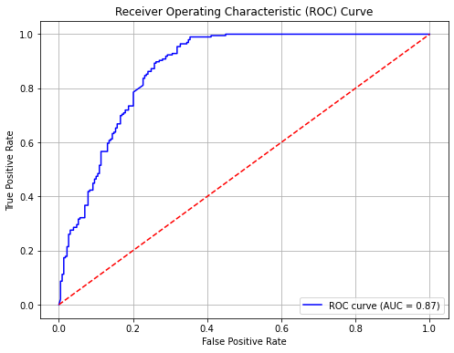
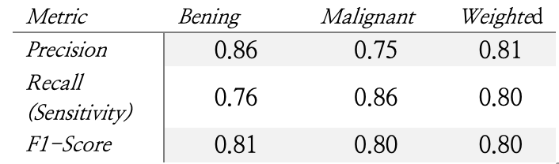
Results
Key Metrics
Accuracy: 80%.
Sensitivity (malignant detection): 86%.
Specificity (benign detection): 76%.
ROC AUC: 0.87

Slide 15
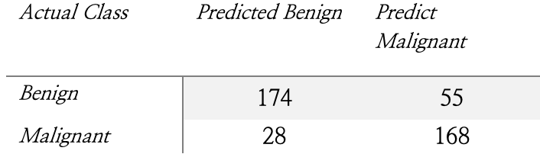
Results
Key Metrics
Accuracy: 80%.
Sensitivity (malignant detection): 86%.
Specificity (benign detection): 76%.
ROC AUC: 0.87

Slide 16
Results
Key Metrics
Accuracy: 80%.
Sensitivity (malignant detection): 86%.
Specificity (benign detection): 76%.
ROC AUC: 0.87

Slide 17
Results
Key Metrics
Accuracy: 80%.
Sensitivity (malignant detection): 86%.
Specificity (benign detection): 76%.
ROC AUC: 0.87.

Slide 18
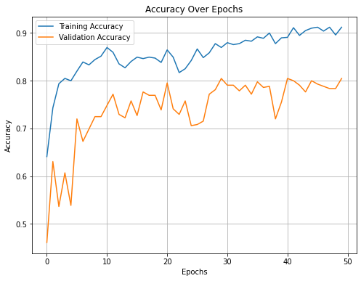
Results
Model Performance
Effectively classifies benign and malignant nodules.
Good balance between sensitivity and specificity.

Slide 19
Results
As we can observe in the accuracy graph, the model achieves a training accuracy of 0.91 and a validation accuracy of 0.8.
This behavior suggests that the model generalizes well, with no apparent signs of overfitting.

Slide 20
Results
As we can observe in the accuracy graph, the model achieves a training accuracy of 0.91 and a validation accuracy of 0.8.
This behavior suggests that the model generalizes well, with no apparent signs of overfitting.

Slide 21
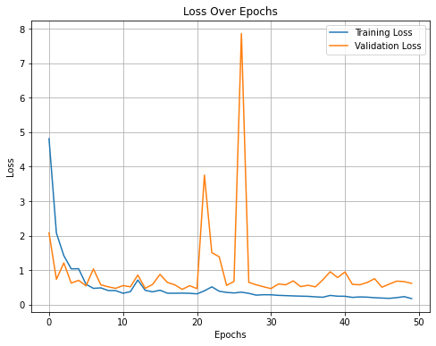
Results
The graph shows that training loss decreases steadily and stabilizes, while validation loss, despite some fluctuations (notably around epoch 30), follows a similar trend.
The alignment between both losses suggests no significant overfitting and good generalization.

Slide 22
Results
The graph shows that training loss decreases steadily and stabilizes, while validation loss, despite some fluctuations (notably around epoch 30), follows a similar trend.
The alignment between both losses suggests no significant overfitting and good generalization.

Slide 23
Results
The training loss is consistently lower than the validation loss towards the end of training.
This could be a slight sign of overfitting, but it does not appear critical as the two curves do not diverge significantly.

Slide 24
06
Discussions

Slide 25
86%
Sensitivity (correctly identify malignant tumors)

Slide 26
80% Acuaccy
76% Specifity
0.87 AUC
Correctly classifies 80% of all nodules
Identifies 76% of benign nodules
Very good performance between benign and malignant

Slide 27
Advantages
Robust Performance
High sensitivity and specificity
Balanced Data
Practility
Data augmentation techniques helped to balance the dataset
Jupiter is the biggest planet of them all
Scalability
Flexible and adaptable model

Slide 28
07
Limitations and Future Work

Slide 29
LIMITATIONS
Computational resources:
Lack of access to advanced hardware (clusters or GPUs).
Prolonged training times and limited experimentation.
Dataset size:
Despite augmentation, the dataset remains relatively small.

Slide 30
Future Work
Computational resources:
Leverage high-performance clusters or cloud platforms (AWS, Google Cloud).
Model enhancements:
Explore advanced architectures (transformers, hybrid models).
Transfer learning using pre-trained medical imaging models.
Validation on real-world data:
Test on independent clinical datasets to assess robustness.
Integrate explainability techniques (Grad-CAM, SHAP).

Slide 31
08
Conclussions

Slide 32
Conclussions
High accuracy, sensitivity and specificity
Support to clinical decision making
Need for future advancements, such as larger datasets, access to high-performance computational resources and validation on real word clinical data.

Slide 33
Conclussions
High accuracy, sensitivity and specificity
Support to clinical decision making
Need for future advancements, such as larger datasets, access to high-performance computational resources and validation on real word clinical data.

Slide 34
Thanks!

